Slide 1
Harnessing the Power of Data to Successfully Drive Ergonomic Program Outcomes with Briotix Health
Presented by: Asha Thompson, Client Program Coordinator

Slide 2
Introduction
What does an effective ergonomics program look like?
Education
Prevention/Intervention
Long-term Outcomes
Does organization or program size/engagement matter?
No!
Notes:
EDUCATION: Before expecting your workforce to be able to identify the source of their discomfort, or even identify the difference between proactive and reactive intervention, it is critical to lay a baseline of education. Successful ergonomic programs ensure that ergonomic and other health & safety standards are known across the board by their workforce as a first line of defense against workplace injury claims and the associated expenses.
PREVENTION/INTERVENTION: Once your workforce is educated on the basics of ergonomics, they can more easily determine on an individual basis which criteria are not met at their workstation, which habits they need to set, and what needs adjustment either by the individual, Facilities/Maintenance, or a professional ergonomist. Some employees may go through the education and find they are right on track and continue engagement with the program at various levels to proactively avoid ergonomics issues.
LONG-TERM OUTCOMES: Successful ergonomics programs track the efficacy of provided education, and the impact of professional intervention – both proactive, and reactive – for the most accurate picture of program health and organizational trends.
PROGRAM SIZE: As long as your program includes the right elements and you are collecting and tracking the right metrics, it does not matter if your organization is big or small or if your list of employees eligible to participate is long or short. The use of data to manage and drive ergonomics programs is also specifically intended to allow you to flex the size of the program, so that as engagement levels fluctuate you are still able to capture the most important outcome information about the program.

Slide 3
Common Mistakes?
Collecting data, but not interpreting it
Collecting data, but not drilling it down
Reporting on program metrics, but not making strategic decisions based on results
Offering ergonomic support, but not implementing stop-gaps to keep costs per case low
Notes:
INTERPRETING DATA: On it’s face, a report that shows how many employees have reached out with a discomfort complaint in a year gives you a really good picture of where your organization needs work. But how many of those employees completed a training first, to ensure they know what a “comfortable” workstation should look like, and still reported discomfort? How many of those employees work in a retail location, or a branch, or an industrial site where they are not able to sit at regular intervals due to their job tasks? How many of those employees reached out to report discomfort after seeing Facilities bring their co-worker in the same office, a new chair or desk? To get the most out of our data, we must be able to put on different lenses and interpret that data in a variety of ways.
DRILLING DOWN DATA: Part of interpreting data effectively is “drilling down” or sorting the data into categories that make sense for your organization and your program. A report of all the discomfort complaints in a year is useful data, but if you address every complaint in that list with the same approach you can expect to see many of those same individuals on the same report next year, and the next, and the next. Even if your overarching goal is still to identify overall discomfort at your company, viewing that same data sorted by hire date, department, job title, or workstyle helps you adjust your approach to each case and make an impact on that overall number of reports year over year.
STRATEGIC DECISION-MAKING: You may be collecting the right data, but is it telling the right story about your organization or how it runs programs for the employee’s benefit? Is the way that you collect and interpret your data empowering you to make the right choices for the future of your ergonomic program? Let’s say last year’s list of discomfort reports had 100 people on it, and this years only has 80. On the surface, a 20% reduction in discomfort across the company demonstrates program efficacy; so you decide to continue the program as-is; but when we take a closer look, let’s say 60 of those 80 employees with discomfort were actually on last year’s list, too. If we aren’t using the data correctly and listening to all it has to tell us, we actually do a disservice to our employees. We missed the messaging in our data that 60% of employees engaged in the program did not see an improvement, we missed the opportunity to find out why, and what appeared as a 20% reduction in discomfort across the org is more likely a 20% reduction in engagement due to the lack of efficacy of the program. Employees stop reporting because they don’t feel it’s effective, not because they aren’t uncomfortable.
IMPLEMENTING STOP-GAPS: Looking at what you spend on average per employee is another great way to determine the overall health of an ergonomics program; reduced spend per employee or overall program spend year over year is nothing to scoff at, especially in these trying times. But understanding how or why those $ amounts fluctuate is essential if we are going to have any sort of control over the spend. Severe discomfort doesn’t have to be synonymous with being expensive. Having different engagement levels within your program allows you some control over who works their way up to the more expensive means of intervention, without gatekeeping relief or solutions. Allowing access to ergonomic intervention at different levels, and placing stop-gaps that you can track in between those levels, helps you to ensure you spend only what you need to per employee while giving all employees the opportunity to address their concerns and learn best practices.
Let’s get into some examples! To determine if you are collecting and making the best use of the most important data, ask yourself: “What”, “Who”, “When”, “Where” and “Why”!

Slide 4
Dealing with Data:
WHAT, WHO, WHEN, WHERE, & WHY?

Slide 5
The “What”…
What kind of data should we be collecting for our ergonomic program?
Employee demographics
Allow you to drill down later when reporting on your data
Reason for seeking support
Proactive/New-hire
Discomfort
Want equipment
Discomfort
Severity, frequency, area of the body
Implemented solutions
Number of requests
Level of intervention completed/reached
Equipment recommendations/procurement status

Slide 6
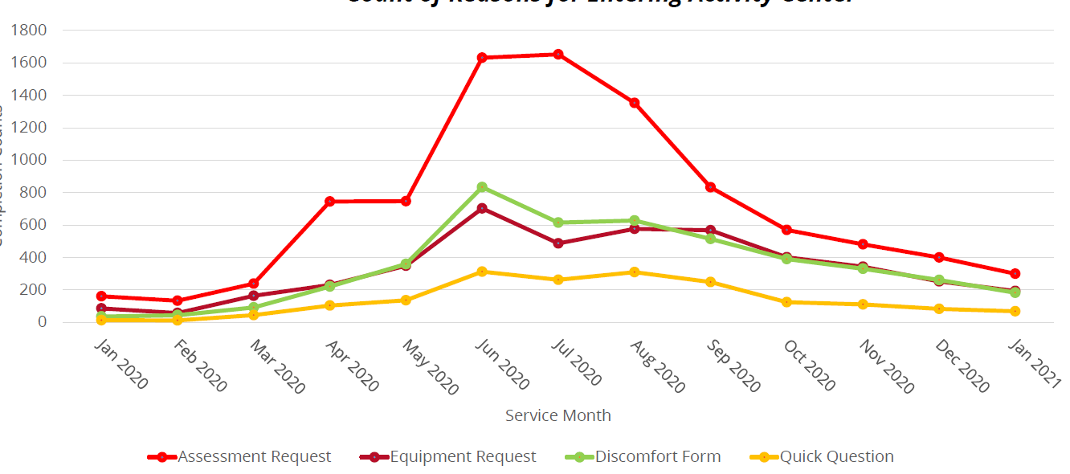
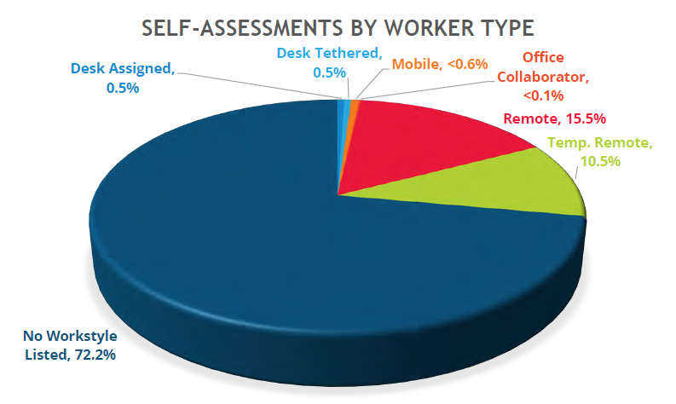
The “What”… (cont’d.)
Metrics like the employee’s physical location, workstyle or workstation type, and job title are examples of data you can collect to identify organizational trends.
Knowing why an employee is seeking support is important because it allows you to tailor your approach to the request type, which can help keep costs per case low.
Tracking a wide variety of case-related metrics over time allows you to paint a picture – where the problems lie, what your organization is doing to fix them, and how well that resolution plan is working.
Notes:
The examples to the right come from program reporting for actual clients – the first graphic shows a scenario where program engagement due to the desire for an ergonomic assessment peaked for a single quarter. If we look at all support requests as one in the same, we would only see that the program increased overall during this time period, and without knowing why we have no way to control those spikes in the future and mitigate the associated spend. By tracking the reason for the support request, we can identify what was going on in the organization at the time that may have prompted the increase and mitigate additional spend by crafting solutions to target those specific employees with that specific concern. The second graphic shows ergonomic assessments in a single quarter broken down by employee workstyle – another great metric to track, especially if your organization has different equipment offerings or different budgets for employees in the office 100% of the time vs. employees who are at home part or full-time, for example.

Slide 7
The “Who”…
Who should be allowed to participate in our ergonomic program?
Everyone!
Interpreting your program data as it reflects on the entire organization, even if only a small group currently participates, helps to forecast the future of the program as well as talk about what groups/departments not currently engaged in the program are missing out on.
Will including everyone increase program costs?
This depends on your program.
If you only offer assessments with an ergonomist and equipment where necessary, cost per case may go up; but if this is a concern, implementing education with a training or webinar, a coaching (no equipment) option, or a virtual meeting option will help you keep program costs low while still capturing lots of engagement!

Slide 8
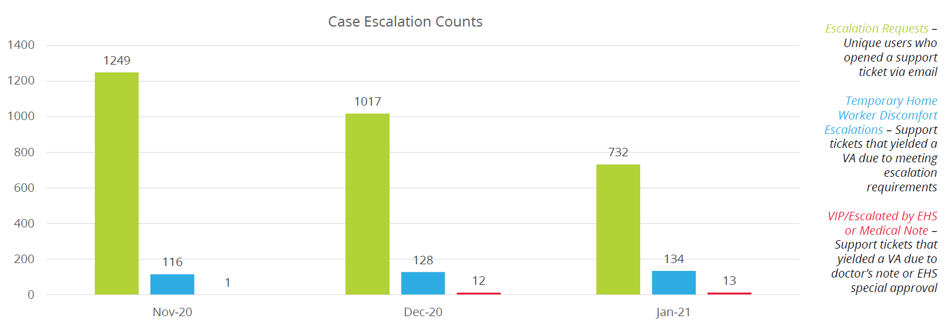
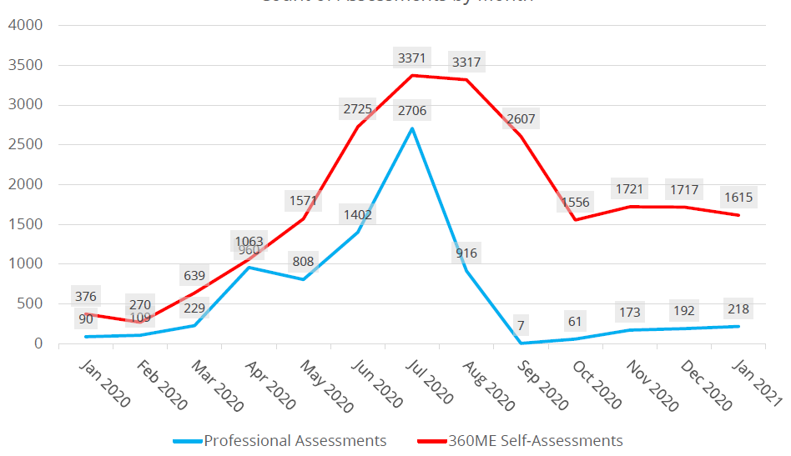
The “Who”… (cont’d.)
Take a tiered or multi-layered approach when rolling out your ergonomics program.
By offering different levels or types of support, you make your program and its benefits more accessible to your employees, whether they are part-time, full-time, remote, hybrid, etc.
Notes:
The first graphic above shows how a client chose to drill down their data, to show the different types of employees and how their cases are escalated. Out of all support requests received in a single quarter, by collecting the right data they were able to identify full-time employees working from home temporarily due to COVID who needed urgent support due to discomfort, and other employees who may not be full-time or working from home due to COVID but have a doctor’s note or special EHS approval for an ergonomic assessment making their request equally as urgent in a different way. This allowed the organization to tailor the ergonomist’s availability to service the employees with the most urgent need. The second graphic shows completion rates of two different levels of support within the same client ergonomic program. One level of support is a low-cost self-assessment that employees can complete to receive tailored workstation advice, and the other is a professional assessment with a live ergonomist. Both levels of support are based on the same foundational education and cover the same areas; but employees have the option to self-resolve, keeping costs per case low for the organization while addressing every single support request.

Slide 9
The “When”…
When should we be collecting the suggested data metrics?
From the moment support is requested, regardless of the reason.
When should we be reporting back to our organization on the collected data?
This depends on your organization.
When you start with the right data, you can report on it at any interval you like – some companies with 1,000 employees or less prefer monthly and yearly reporting, with an emphasis on engagement and equipment trends. Larger programs with tens of thousands of employees prefer quarterly and fiscal yearly reporting, with an emphasis on program spend and returning user trends.
Notes:
The takeaway here is that as long as you collect it, you can report on it how and whenever you’d like.

Slide 10
The “Where”…
Where should we be collecting the suggested data metrics?
The more centralized, the better!
Tracking your case statuses and your case outcomes all in one place makes getting the most out of your data as simple as possible.
For an ergonomics program to be successful, an organization’s HR, Workplace Resources or Environmental Health & Safety, Procurement, and Finance teams are all involved and aware of program trends.
Notes:
When organizations approach ergonomics and ergo program data with this kind of team effort, it becomes possible to track a case from hire date, to assessment date, to equipment order and installation. Taking all the data you collect and following it through to the end of the case helps to ensure better overall outcomes. We lose fewer employees on steps of the process that involve other departments, and we have more opportunities to intervene before an employee has to come back through the program a second time, or before we spend more than we have to on changes to the employee’s workstation.

Slide 11
The “Why”…
Why should we pivot our current program to start collecting more data?
Small changes to the way you collect and use your ergonomics program data can:
Improve ergonomic risk mitigation
Increase employee engagement
Allocate resources more efficiently (both funding and inventory)
Reduce costs while improving outcomes
Notes:
A great ergonomics program is not just about preventing injury – it’s about improving the employee’s experience of your organization. We learn more everyday that when companies care, employees work smarter and harder. Pouring into your workforce by ensuring their comfort in the interest of their safety ensures that they pour back into you.
Expanding your program and promoting engagement ensure that you receive enough input to be able to use all the data you collect, as well as increase your chance of catching every potential injury on the horizon in your organization and address it
Refining and improving the data you collect to manage your program from case start to finish also allows you to track program spend and budget more effectively, as well as track physical inventory like office equipment more effectively; you’ll know not only what’s moving where, but WHY!

Slide 12
In Summary…
Data to Collect:
Who is the employee? Build a profile to understand the individual.
How is the employee requesting support?
Why is the employee requesting support?
What level of support is needed?
What solutions are available at that support level?
Is the employee engaging in the solutions?
After implementing solutions, how has the support request evolved?
Trends to Track:
What support requests are most common? Least common?
How long does a single case take on average from start to finish?
How much administrative time is spent per case? How much is spent on equipment?
How effective is each level of support/intervention offered?
What body part is reported as having discomfort most frequently? Is there a particular department that reports this body part the most?
…and more!
Choices to Make:
Increase or decrease program stopgaps to control program spend without limiting access,
Distribute educational resources tailored to specific departments, roles, or the program as a whole to proactively mitigate risk in high-risk sectors,
Tailor equipment offerings and how/when they can be recommended to control both program/procurement spend and program engagement,
Add enhancements and supplemental services to your program to fill gaps, participate in Health & Safety initiatives,
…and more!

Slide 13
Thank you!

